Slide 1
HTS Machine Learning Showcase

Slide 2
Introduction
Machine Learning
A set of algorithms and a subset of AI used to train predictive models.
They determine what attributes matter and the best way to predict an outcome.
The HTS ML model uses existing data to predict likelihood of a person being HIV positive during HTS client screening.
Notes:
In this Case some of the attributes are: -
Gender
Age
Martial status
Entry point
Testing strategy
etc

Slide 3
HTS Client Current Workflow
Fill HTS eligibility/screening form in the HTS app/EMR/form
HIV Test Offered
Start
Session
No
End
Session
Yes
Test and fill data in HTS app/EMR/form

Slide 4
Data Sources
KeHMIS National Data Warehouse Repository of patient screening information and test results
Features generated from this information, such as the month and day of week of a test, and the type of facility
Demographic, socio-economic, and HIV-relevant metrics from 5-km area around the facility
Demographic data from Facebook Data 4 Good and World Pop
Socio-economic data from UN
HIV metrics from Institute of Health Metrics and Evaluation (IHME)
Notes:
to guide eligibility screeners on additional questions to ask during screening.
to guide recommendations on testing screening & strategies at county level.
Deployment of the HTS Model Web application will be used to elicit interest in predicting testing outcome.

Slide 5
Rationale
From the total HIV tested clients in the warehouse (1,612,369) approximately 3.6% are positive (58,597).
With constraints in both human resource and test-kits, there is need for improved testing outcomes through focused testing.
Notes:
In this case Positive cases vs the number of tested clients
to guide eligibility screeners on additional questions to ask during screening.
to guide recommendations on testing screening & strategies at county level.
Deployment of the HTS Model Web application will be used to elicit interest in predicting testing outcome.

Slide 6
Implementation of the HTS Model
The model would be applied at facility level through an app to guide eligibility screeners on additional questions to ask during screening.
The model would be applied at the National Data Warehouse level to guide recommendations on testing screening & strategies at county and national level.
Notes:
to guide eligibility screeners on additional questions to ask during screening.
to guide recommendations on testing screening & strategies at county level.
Deployment of the HTS Model Web application will be used to elicit interest in predicting testing outcome.

Slide 7
The HTS ML App/portal will be used to aid in achieving the 3 main ‘Wh’ questions;
Who - improving testing outcomes through having the HTS providers identify people/person to test.
Where - the place/location to intensify testing activities.
When - the time/period to undertake/intensify the testing activities.

Slide 8
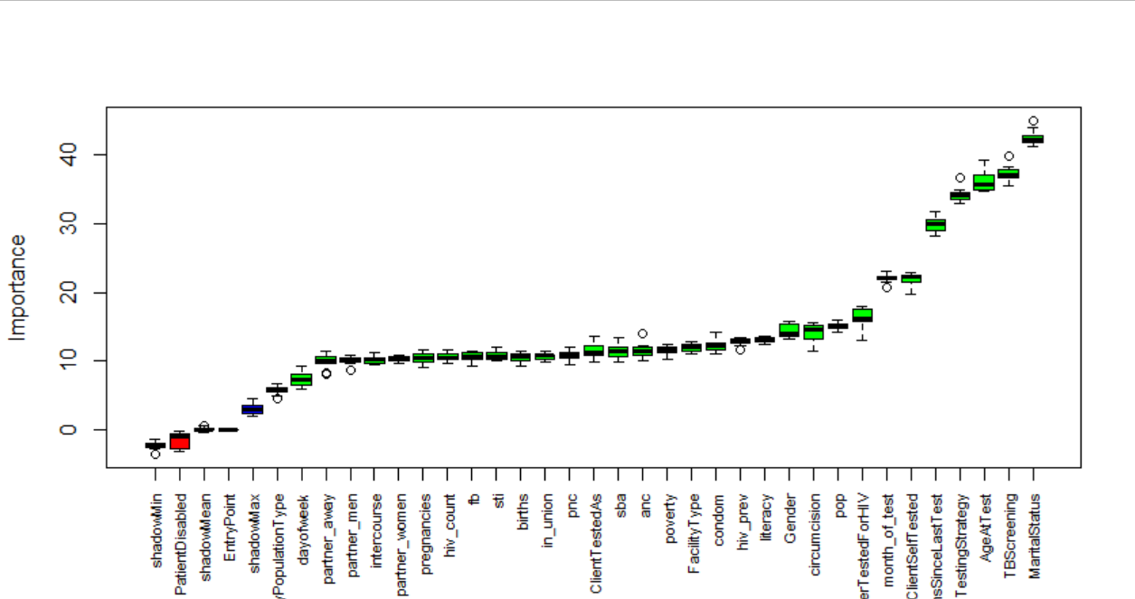
Feature Importance - Boruta
Notes:
to guide eligibility screeners on additional questions to ask during screening.
to guide recommendations on testing screening & strategies at county level.
Deployment of the HTS Model Web application will be used to elicit interest in predicting testing outcome.

Slide 9
Model Training and Testing
Split dataset into train, validation and test sets using 60-20-20 split
Train logistic regression, random forest, XGBoost, support vector machine, and neural networks
Tune model hyperparameters to improve predictive performance on validation set
Notes:
to guide eligibility screeners on additional questions to ask during screening.
to guide recommendations on testing screening & strategies at county level.
Deployment of the HTS Model Web application will be used to elicit interest in predicting testing outcome.

Slide 10
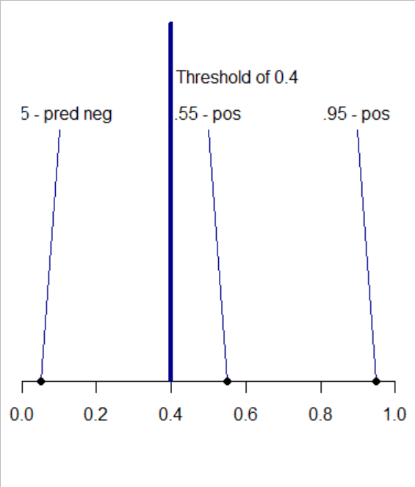
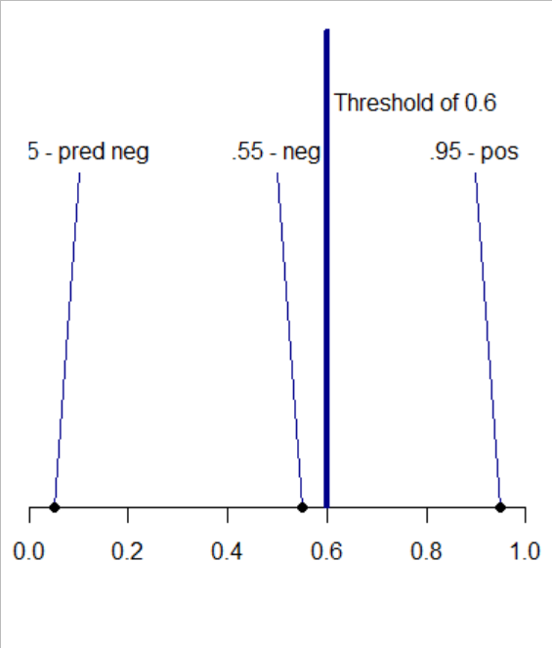
Model Evaluation – Understand Predictions
Predictions are not binary "positive" or "negative"; rather, they are numbers between 0-1 akin to probabilities.
With a low threshold of 0.4, we treat a .55 prediction as a "positive" prediction
With a high threshold of 0.6, we treat a .55 prediction as a "negative" prediction

Slide 11
Model Evaluation – Precision and Recall
Precision: #predicted positives that are in fact positive / #predicted positive
Recall: #predicted positives that are in fact positive / #actual positives

Slide 12
Model Evaluation – Precision and Recall
If the 0.55 prediction is in fact negative:
Precision: 50% (1 / 2)
Recall: 100% (1 / 1)
Precision: 100% (1 / 1)
Recall: 100% (1 / 1)

Slide 13
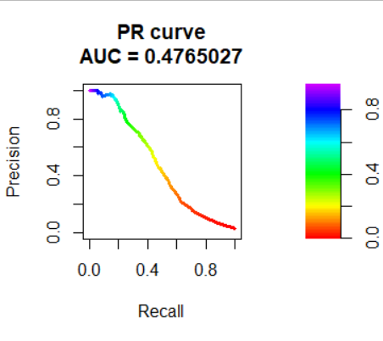
Best Performing Model Random forest
For each threshold from 0 – 1, we calculate precision and recall and plot the points on a curve (see right). The best performing model is the one that maximizes the area under this curve.

Slide 14
HTS Client with ML App Workflow
Start
Session
HTS Screening using HTS Client assessment portal
Generate & Save prediction
Fill HTS eligibility/screening form in the HTS app/EMR/form
Test Offered
End
Session
No
Yes
Record test results in HTS Client assessment portal
Test and fill data in HTS app/EMR/form

Slide 15
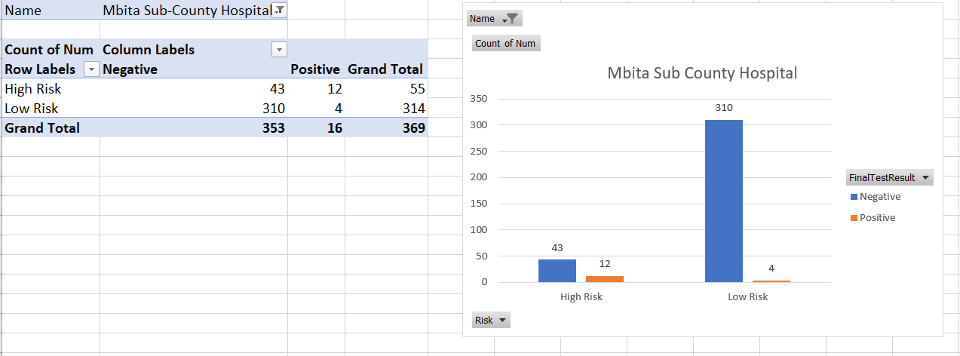
Mbita Output

Slide 16
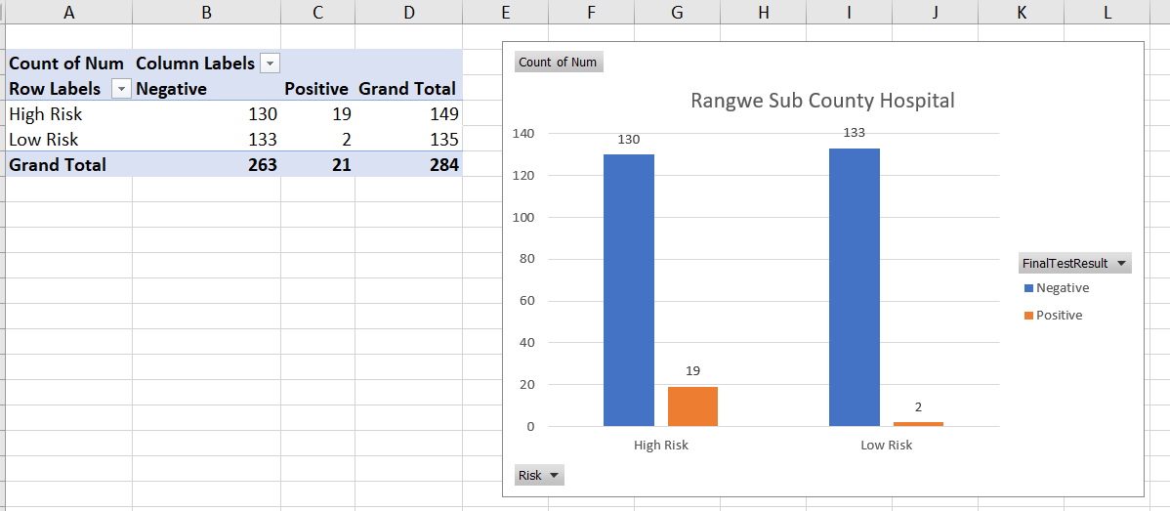
Rangwe Output

Slide 18
Demo https://data.kenyahmis.org:3838/

